Slide 1
ES 415
Bioinspired Catalysts for renewable energy/Energy Harvesting
Under the Guidance of Prof. Raghavan Ranganathan
Patel Vashisth 19110158
Umang Agrawal 19110173

Slide 2
Introduction
Renewable energy and energy harvesting play a critical role in addressing the growing energy demands of the world, while also reducing greenhouse gas emissions and mitigating climate change.
Bioinspired catalysts are catalysts that are designed based on natural catalysts found in biological systems, such as enzymes.
These catalysts are designed to mimic the structure and function of the natural catalysts, and they are used to accelerate chemical reactions in a variety of applications, including renewable energy and energy harvesting.
Bioinspired catalysts are particularly relevant to renewable energy and energy harvesting because they are often more efficient and selective than traditional catalysts
Notes:
Transitioning towards a post-oil society (the so-called ecological transition) requires breakthroughs in finding new catalytic materials that are efficient and stable.

Slide 3
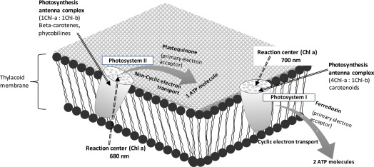
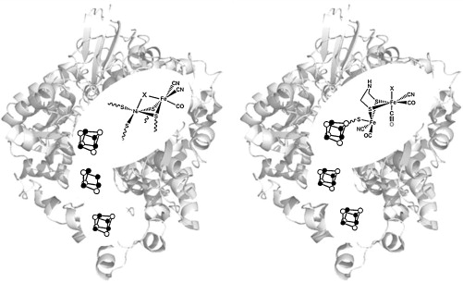
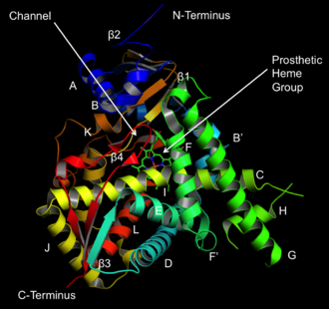
Examples of Bioinspired Catalysts
Bioinspired catalysis is a field of research that aims to mimic or learn from the catalytic processes that occur in living organisms, such as enzymes, cofactors and photosynthetic systems
Some key examples of bioinspired catalysts include:
Photosystem II (PSII) - This is a complex of proteins and pigments found in plants and algae that is responsible for converting sunlight into chemical energy.
Hydrogenases - These are enzymes found in some bacteria that catalyze the conversion of protons and electrons into hydrogen gas.
Cytochrome P450 - This is a family of enzymes found in many organisms that are involved in the metabolism of drugs and other compounds.
Notes:
Bioinspired catalysis has many applications in renewable energy and energy harvesting. For example, bioinspired catalysts can be used to produce hydrogen gas from water, which can be used as a clean fuel source. They can also be used to convert carbon dioxide into useful products, such as fuels and chemicals. Additionally, bioinspired catalysts can be used in energy harvesting devices, such as solar cells and fuel cells, to improve their efficiency.
Extra: photosystems are found in the thylakoid membranes. There are two kinds of photosystems: photosystem I (PSI) and photosystem II (PSII) (Fig. 3.3). PSII acts first during the light transformation process in photosynthesis, but it was named PSII because it was discovered second.

Slide 4
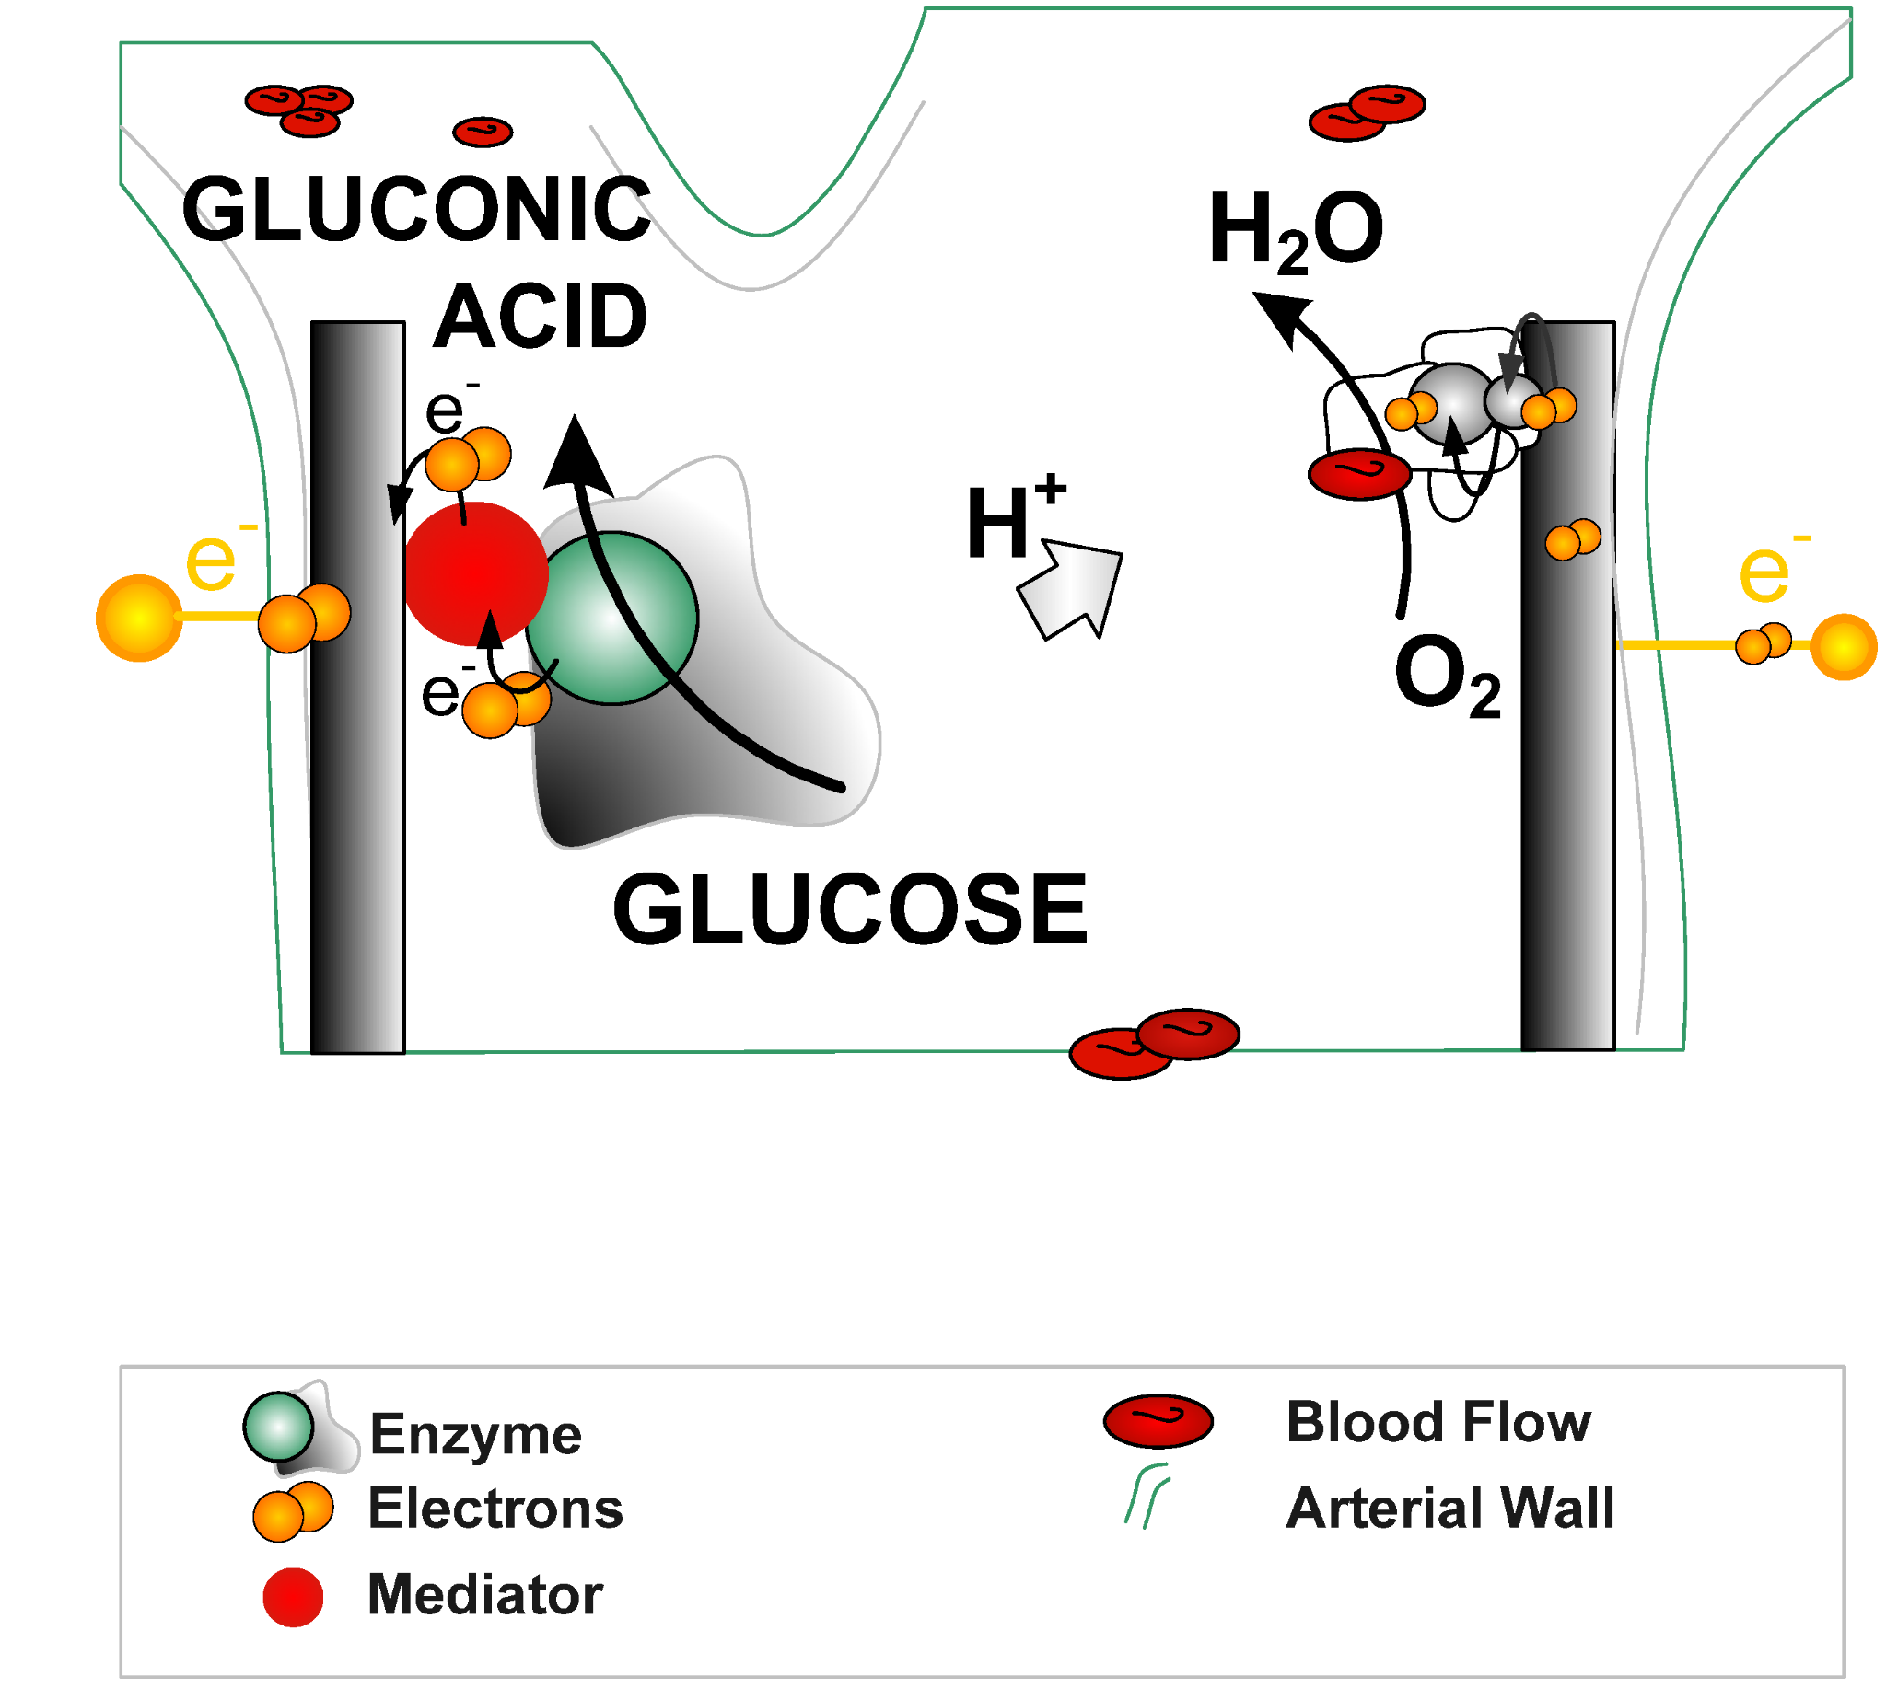
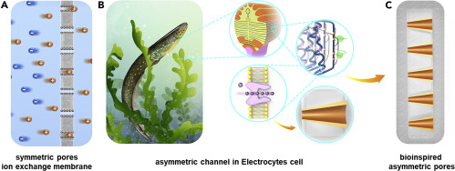
Types of Bioinspired Catalysts
These are the types of bioinspired catalysts used for energy harvesting:-
Enzymatic biofuel cells: Use enzymes to convert organic fuels into electrical energy; potential for medical devices and small electronic devices
Photosynthetic biohybrid systems: Use natural or artificial photosynthetic complexes to convert solar energy into electrical energy; high energy conversion efficiencies and sustainable
Biomimetic membranes: Synthetic membranes that mimic natural biological membranes; used for proton exchange reactions in energy harvesting processes such as fuel cells and electrolysis
Bioinspired electrocatalysts: Materials that mimic natural enzymes to enhance efficiency of chemical reactions in fuel cells
Notes:
Bioinspired catalysis has many applications in renewable energy and energy harvesting. For example, bioinspired catalysts can be used to produce hydrogen gas from water, which can be used as a clean fuel source. They can also be used to convert carbon dioxide into useful products, such as fuels and chemicals. Additionally, bioinspired catalysts can be used in energy harvesting devices, such as solar cells and fuel cells, to improve their efficiency.

Slide 5
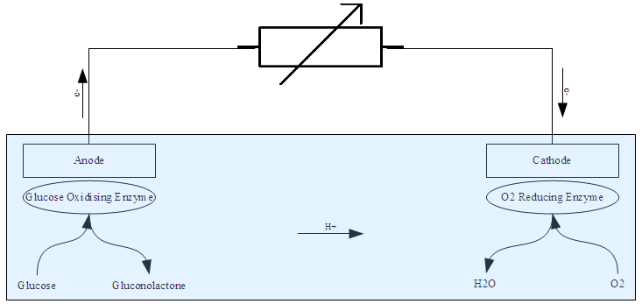
Enzymatic Biofuel Cells
Enzymatic biofuel cells (EBFCs) are promising devices for biomedical, environmental and portable applications, as they can use renewable and biocompatible fuels and operate at mild conditions.
At the anode, glucose is oxidized by glucose oxidase to produce gluconolactone. While at cathode, oxygen is reduced by laccase to produce water
Enzymatic biofuel cells have advantages such as cost-effectiveness(easy to mass-produce and cheaper than precious metals), mild operating conditions, and high efficiency, scalability, versatility, and selectivity.
As they can process organic compounds such as sugars, Sony has developed a biofuel cell using sugar as the fuel and enzymes as catalysts to power a Walkman®
Notes:
Glucose + O2 → Gluconolactone + H+ + e-
Enzymatic biofuel cells are bioinspired because they mimic the way living organisms generate energy through biochemical reactions. Just like the way cells use enzymes to catalyze reactions and generate energy, enzymatic biofuel cells also use enzymes as catalysts to convert chemical energy into electrical energy.
Furthermore, the choice of enzymes used in enzymatic biofuel cells is often inspired by natural systems. For example, glucose oxidase and laccase are enzymes that are naturally found in fungi and bacteria, where they play important roles in the metabolism of organic compounds. By using these enzymes in biofuel cells, researchers are able to harness the natural abilities of these enzymes to efficiently convert organic compounds into electricity.
Sony has developed a biofuel cell using sugar as the fuel and enzymes as catalysts to power a Walkman®

Slide 6
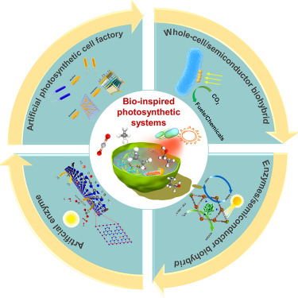
Photosynthetic Biohybrid System
Photosynthetic Biohybrid Systems seek to mimic the natural process of photosynthesis by using living photosynthetic organisms or their components to generate electrical energy.
It is based on the working of photosystem, which consists of a network of proteins and pigments that absorb light and use its energy to generate an electron flow.
A photosynthetic biohybrid system typically consists of these two parts:
Light-harvesting part: Made of artificial materials that can absorb and transfer light energy efficiently, such as nanomaterials, polymers or dye molecules
Catalytic part. Made of biological components that can use the light energy to drive specific reactions, such as water splitting, carbon dioxide reduction or organic synthesis.
Notes:
integrate photosynthetic proteins or microorganisms with semiconducting nanomaterials to harvest and store solar energy in chemical bonds.
Photosystem II is a protein complex located in the thylakoid membranes of chloroplasts in plant cells, as well as in the membranes of cyanobacteria and some algae. It is responsible for the initial step of the light-dependent reactions of photosynthesis, which involves capturing light energy and using it to oxidize water and generate oxygen, protons, and electrons.

Slide 7

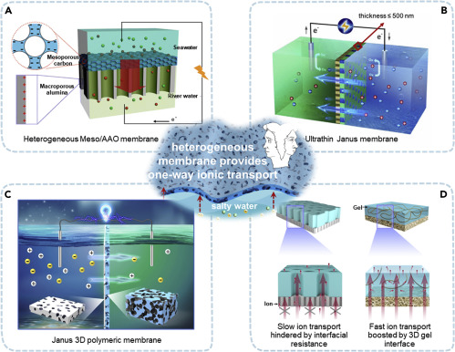
Biomimetic Membranes
A unique kind of renewable energy generation from salinity gradient at the river - sea junction.
Two approaches : 1) Pressure related osmosis, 2) Reversed Electrodialysis.
Eel produces electricity by selectively accumulating different ions with cell membranes.
Presence of electrocyte cells help generate electricity when there is a need for response.
The heterogeneous membrane structure of eel cells has been implemented in different biomimetic material
Ion exchange membrane with symmetrical structure has problem of counterion accumulation at surface.
The different surfaces on both sides of membrane helps in removing this hindrance.
Notes:
Symmetrical cell membranes with charged surfaces is the best practice for selective diffusion nowadays.
Due to presence of same membrane surfaces both sides, the counterions get accumulated on the surfaces which decrease the ionic flow.
Problem with selectivity and permeability.
Eel : Presence of K ions in cytoplasm and Na ions in extraellularmatrix requires different shape of membrane pores.
A : Meso and AAO heterogeneous membrane for osmotic energy harvesting
B : 500 nm tailor made membrane to increase permeability
Challenges (antifouling ability and ultra-high permeability is a problem)

Slide 8
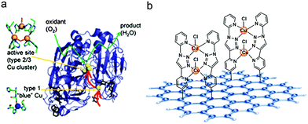
Bioinspired Electrocatalysts
Oxygen Reduction Reactions are necessary to produce electrical energy from Hydrogen fuels.
Nobel-metal are predominantly used as the ORR catalysts which make the process coastly.
Mamy cathodic materials used have relatively higher overpotential for the reaction.
Nature undergoes similar process of oxygen reduction. The enzyme used in many bacterias, fungi is Laccase.
The biomimetic cathode used is rGO-TADPyCu.
The reaction taking place at anode is,
4H⁺ + 4e⁻ + O₂ → 2H₂O
Cu ions have a high efficiency in transportation of electrons for oxygen reduction.

Slide 9
Challenges and Future Directions
Challenges associated:
Stability of enzymes in different environment conditions for longer times.
Mimicking the structure at various length scales and its production.
Scaling up their use to make larger platforms.
Integration into existing renewable energy systems.
Poor understanding of natural structures and establishment of structure property relationships.
Future Directions:
Photosynthetic Biohybrid system- Improving light-harvesting efficiency, and enhancing charge transfer mechanisms.
Enzymatic Biofuel Cells- Increasing the load of enzymes, and optimizing enzymes fixation strategies.
Biomimetic Membranes- Improved efficiency in marine environment, and large scale structures.
Bioinspired Catalysts- better control over ORR reactions, and cost-effective cathode production.

Slide 10
References
Yu, E.H.; Scott, K. Enzymatic Biofuel Cells—Fabrication of Enzyme Electrodes. Energies 2010, 3, 23-42. https://doi.org/10.3390/en3010023.
Yu, E.H., Scott, K. (2020). Enzymatic Biofuel Cells—Fabrication of Enzyme Electrodes. Current Opinion in Electrochemistry, 22, 88-94. https://doi.org/10.1016/j.coelec.2020.06.007.
""Cytochrome P450." Wikipedia. Accessed April 25, 2023. https://en.wikipedia.org/wiki/Cytochrome_P450.
"Enzymatic Biofuel Cell." Wikipedia. Accessed April 25, 2023. https://en.wikipedia.org/wiki/Enzymatic_biofuel_cell.
"Photosystem." ScienceDirect. Accessed April 25, 2023. https://www.sciencedirect.com/topics/agricultural-and-biological-sciences/photosystem.
L. Castro-Grijalba, R. Reyes-Serrano, G. Morales-Ortega, J. F. Escobar-García, S. Martínez-Martínez, E. A. Chavez-Rivas, "Electrochemical analysis of a glucose/O2 enzymatic biofuel cell using [FeFe]-hydrogenases and bilirubin oxidase immobilized on chitosan-carbon nanotubes," Journal of Electroanalytical Chemistry, vol. 895, 2021, article number 115431. https://doi.org/10.1016/j.jelechem.2021.115431

Slide 11
THANK YOU!

